Slide 1
Why History Matters

Slide 2
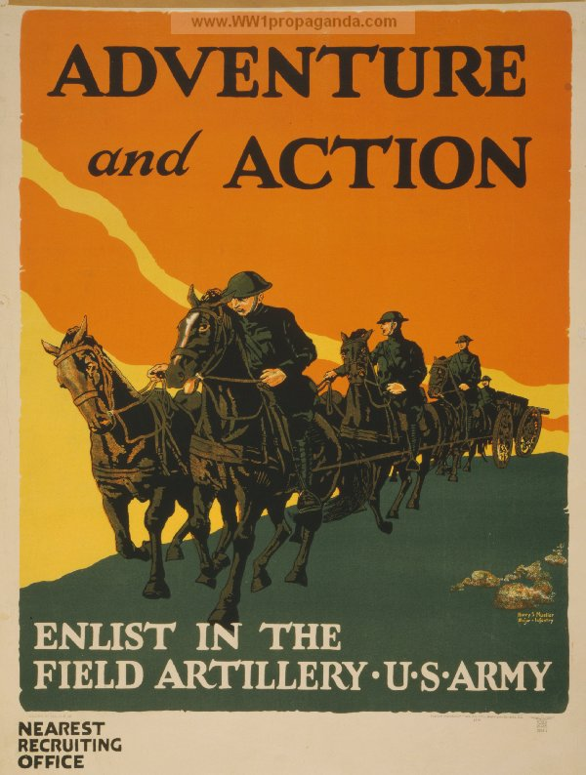
What is History?
What do you think of when you hear the word history?
Is it just a list of dates and facts?
More crucial aspects include:
Ideas and beliefs held in the past
The interpretation of past events
Looking at different perspectives and understandings

Slide 3
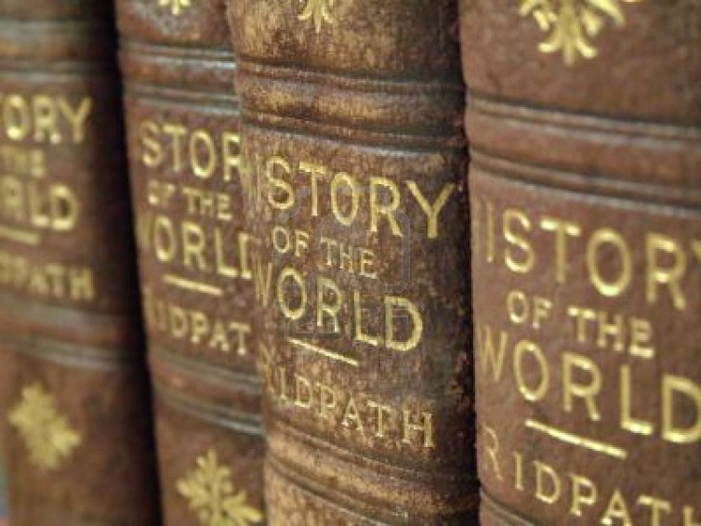
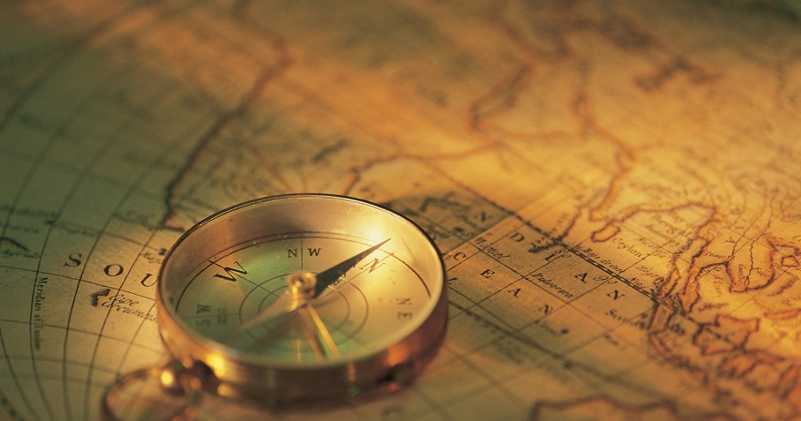
Why does history matter?
History situates events in context
History helps us understand human nature
History helps us understand who we are today – what aspects of who we are is universal, and what aspects are temporally-specific?
History helps us explain how people interact and relate to each other across time

Slide 4
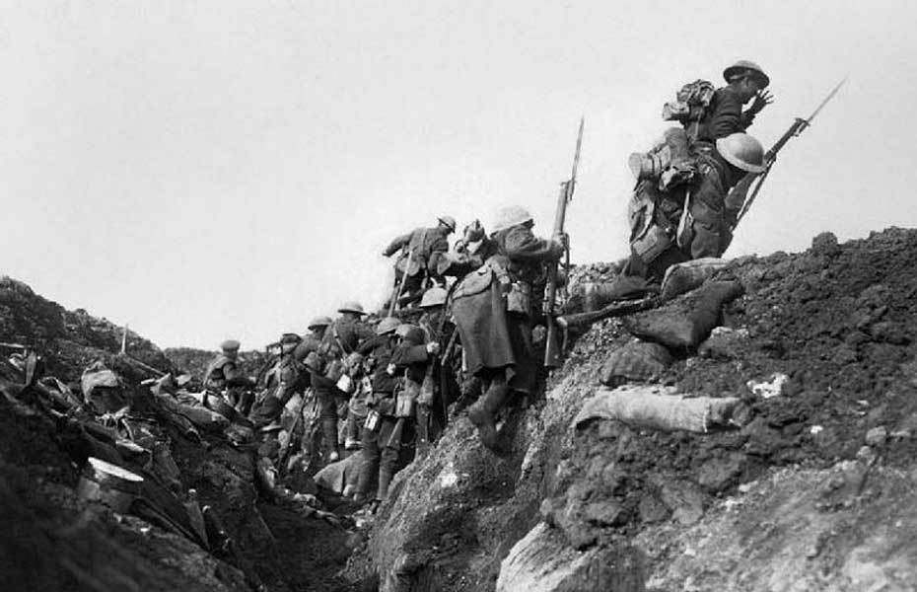
Why does history matter?
History explains WHY things are the way they are
History informs present-day issues
It is NOT about learning from past mistakes!

Slide 5
The First World War
Why is the First World War also referred to as « The War » and « The Great War »?
Why does studying it matter?
How has The war affected your life?
We will look at this in our activity

Slide 6
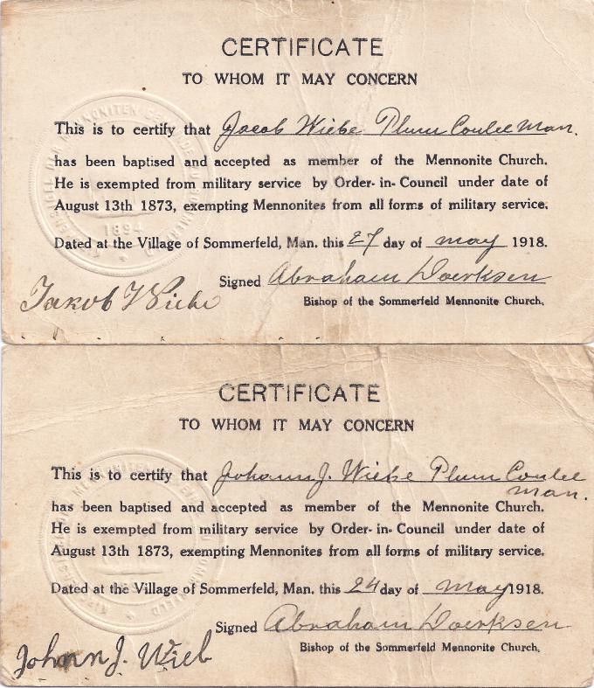
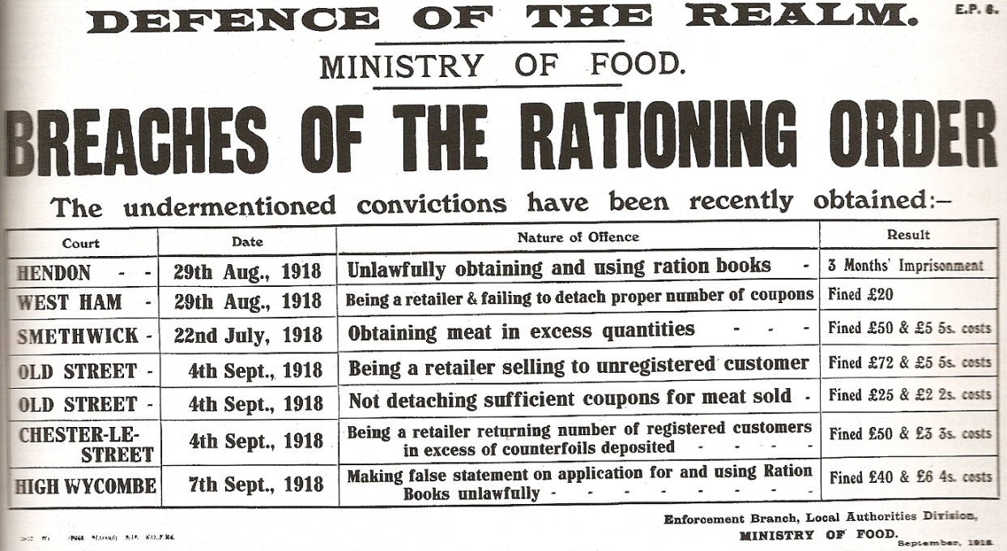
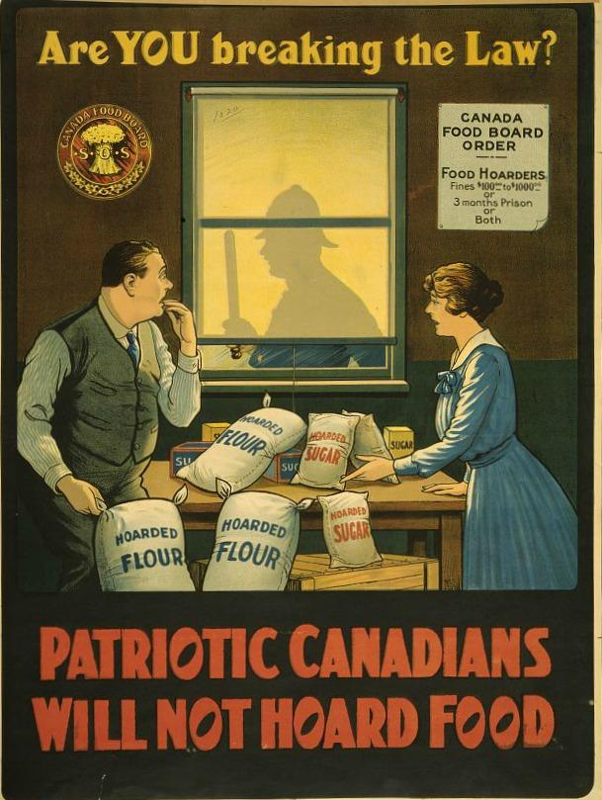
Activity
In groups, we are going to look at the ways The Great War changed us – here in Saskatchewan, in Canada, and the world.
We will make a newspaper about how The War, and history, affect us today.

Slide 7
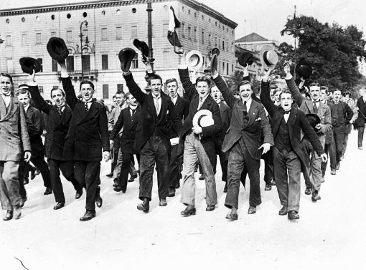
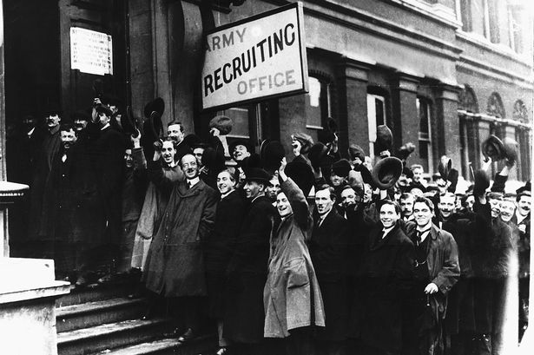
Group A – Attitudes Towards War
Using a newspaper article, propaganda posters, and a poem, you will discover how opinions about war changed from the start to the end of The War.

Slide 8
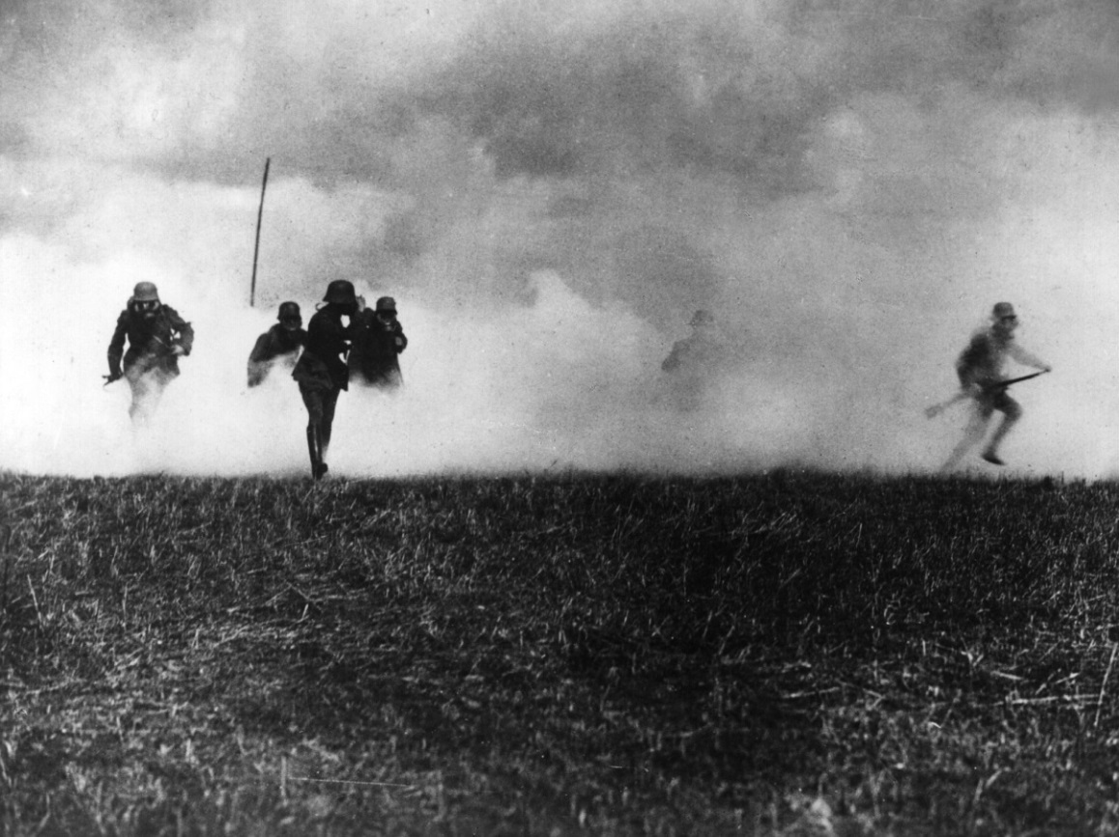
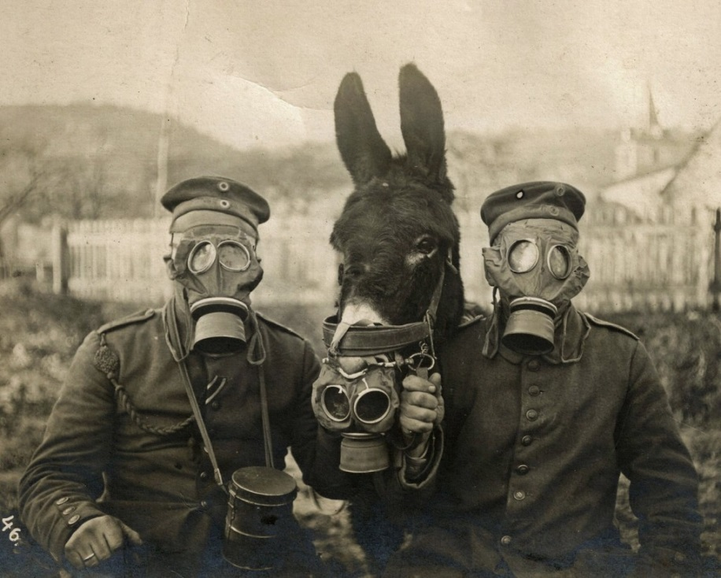
Group B: Scientific/Weapons Development
Using documents and photos, you will assess which inventions were positive, which were negative, and how our opinions about them have changed.

Slide 9
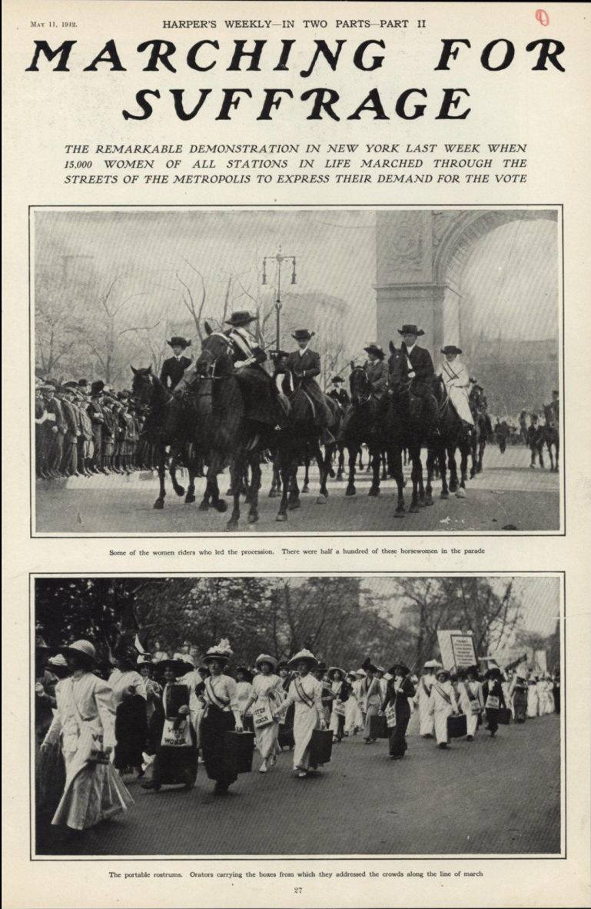
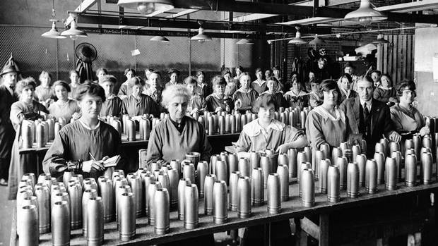
Group C – Women’s Suffrage and Changing Roles
Using a propaganda poster, a newspaper article, and new information, you will write about how The War changed women’s rights.

Slide 10
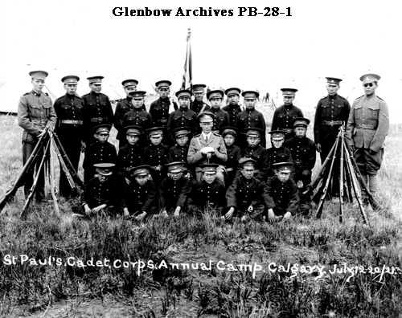
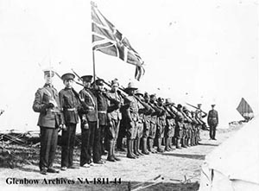
Group D: Attitudes Towards Aboriginal People and Immigrants
Using propaganda, photos, and new information, you will assess how attitudes towards Aboriginal people and immigrants changed – and how it stayed the same.

Slide 11
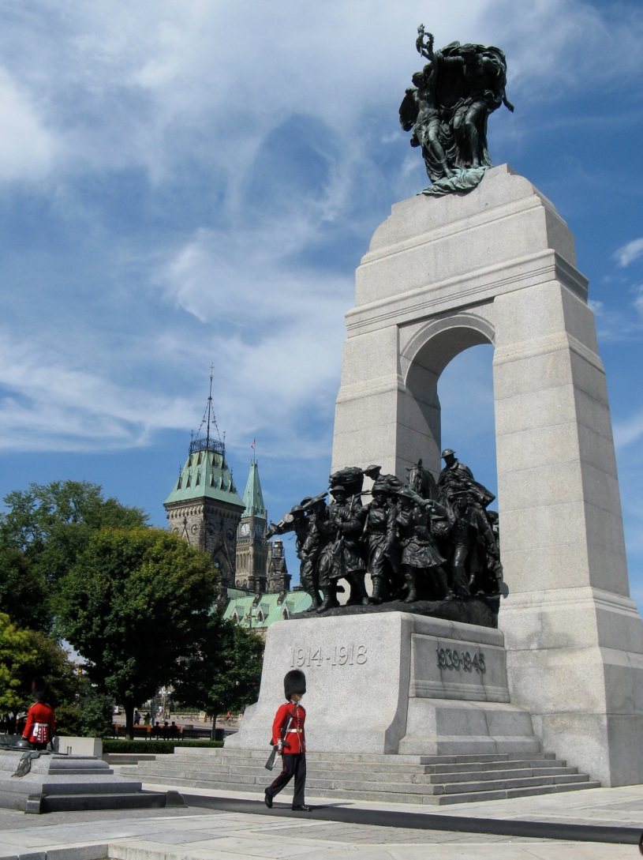
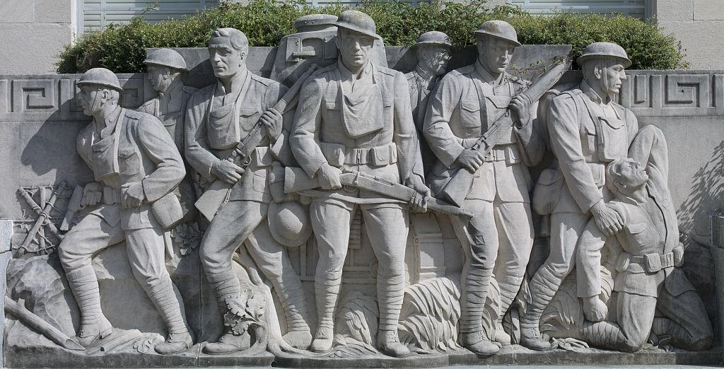
Group E: Vimy Ridge and Memorials
Using photos and letters sent from France during The War, you will look at how we remember The Great War and how it affects us still.

